Slide 1
TG-120 and Ezzel paper Quiz
10/31

Slide 2
Q1
TG-120 lists a number of detectors that can be used for IMRT QA.
List the detectors for 1D measurement
Provide pros and cons of each

Slide 3
Q2
TG-120 lists a number of detectors that can be used for IMRT QA.
List the detectors for 2D measurement
Provide pros and cons of each

Slide 4
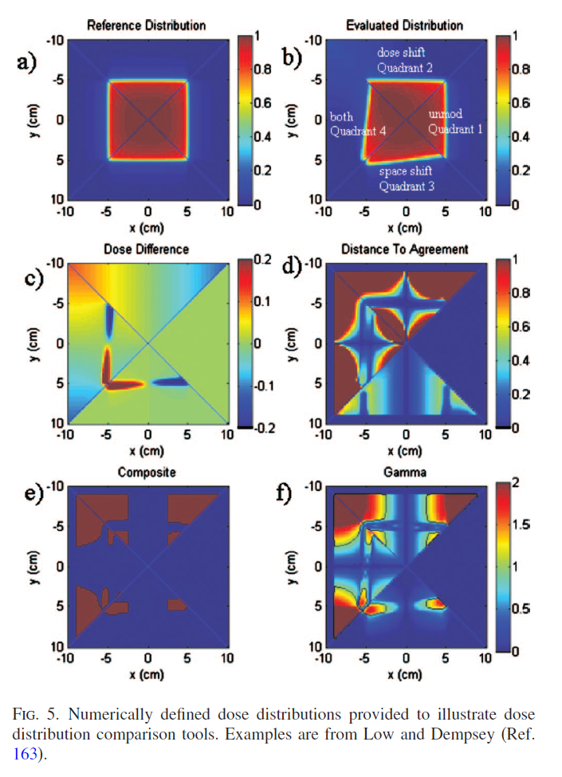
Q3
What is being tested here?
The evaluated dose distribution in quadrant 2 has been scaled such that the dose varies by 6% at the field edges 1.2% cm−1 dose gradient. The evaluated dose distribution in quadrant 3 has been shifted by 1.2 mm for each cm of off-axis distance to mimic spatial discrepancies between dose distributions.

Slide 5
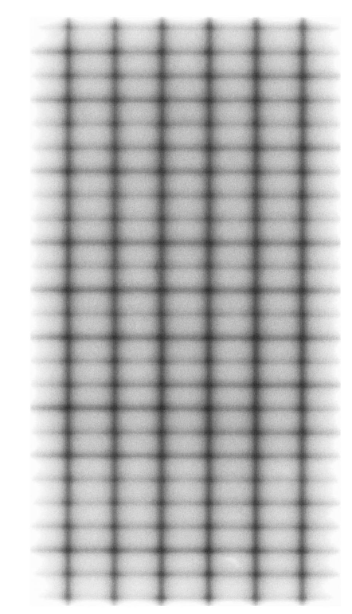
Q4
What is being tested here?
What other tests are performed for this type of equipment?
How often should you test this equipment?

Slide 6
Q5
Explain the differences between IMRT and conventional treatment planning for:
Dose calculations and beam modeling
Planning algorithms and planning “issues” (e.g. contours)
Notes:
Flash
Target in air or skin surface
MU calcs

Slide 7
Q6
Explain process of clinical implementation of IMRT
Shielding
Space planning
Equipment
Time and personnel requirements
Immobilization
Imaging Requirements
Training

